Slide 1

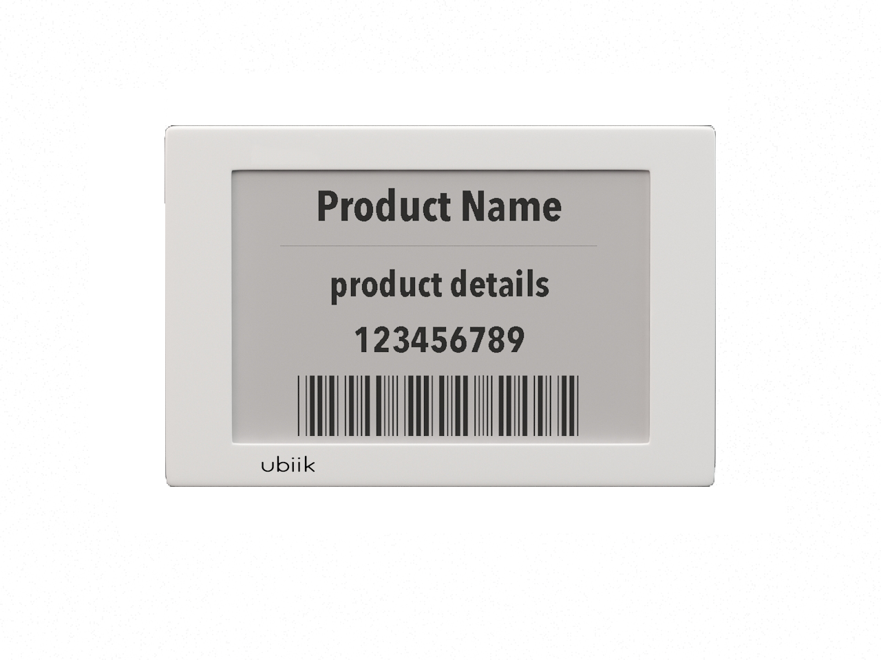
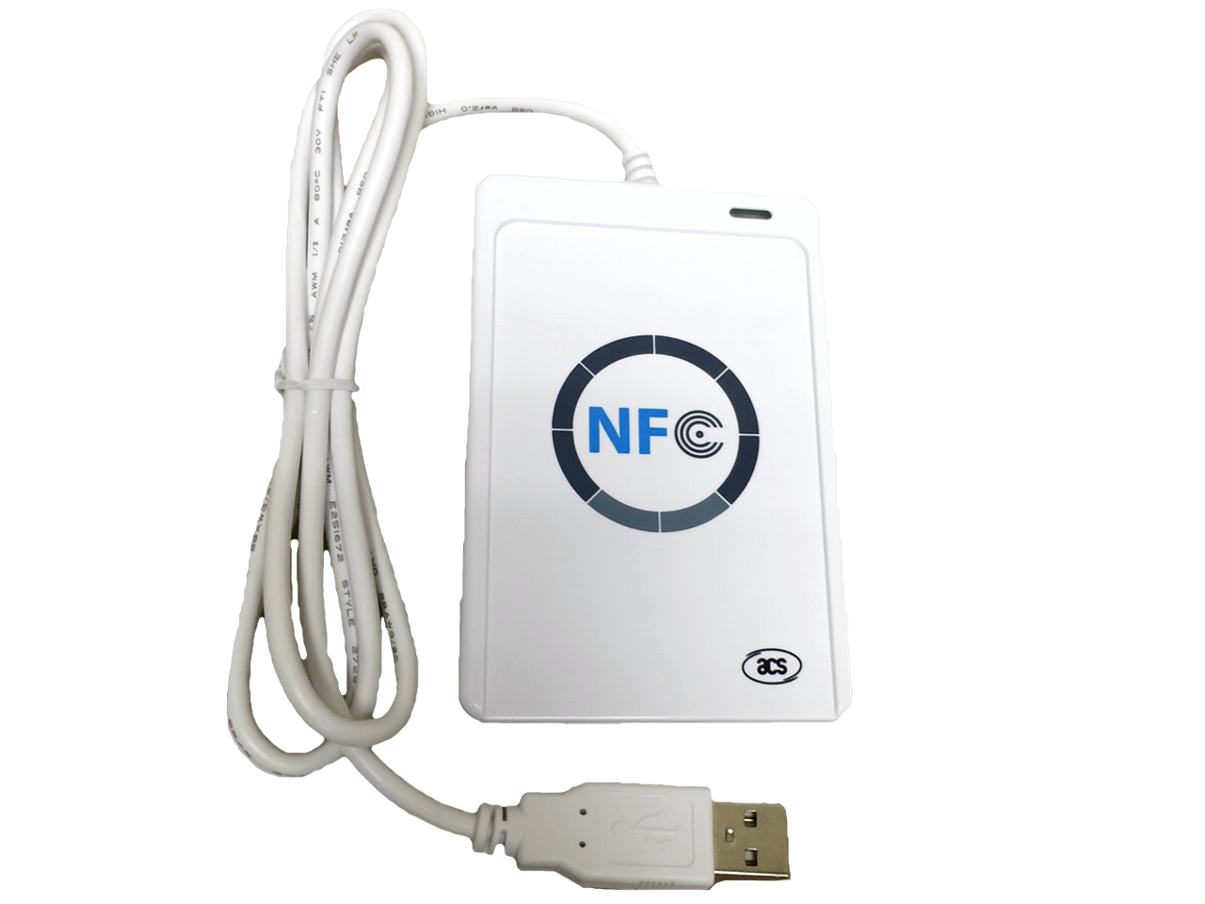


PC Software
Function: user creates a customized images using templates and then triggers the external NFC reader to send the image to our E-Paper Tag
Your Job: Create the GUI described in this document. The actually sending of the image via NFC will be facilitated on our end. Therefore the “send button” should be an empty function that we will code ourselves.
Language: C or C++
**please note this is very rough mock-up. Freelancer is expected to design user-friendly UX
E-Paper Tag

Slide 2
Key Details
Software will be generating images suitable to be displayed on 3 different sizes the 2.1” 2.7” and 4.2” e-paper screen specs
Image needs to be 1 bit format (black and white) and also software must support image dithering
Specs 4.2” : resolution 400(h) x 300(w) /pixel pitch 0.212 x 0.212
Specs 2.7”: resolution 264 x 176 /pixel pitch 0.217 x 0.217
Specs 2.1”: resolution 212 x 104 / pixel pitch 0.229x 0.228
user can upload BMPimage or JPG file
Image processing flow: BMP/JPG -> dithering -> 1 bit BMP
If the image uploaded is larger than selected screen size than image will be pinned to top left corner or e-paper screen and display what is possible (the rest will be cropped out, no scaling will take place)
If the Image uploaded is smaller than selected screen size than image will be pinned to top left corner and remaining screen should be (“zeros”/blank )

Slide 3
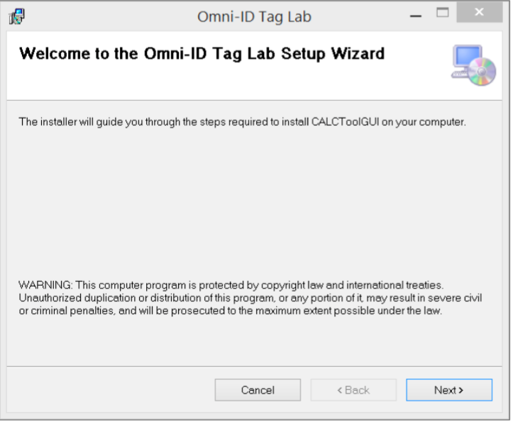
Installation
Double-click on the setup.exe file and follow the prompts to install the application.
Welcome to the Ubiik NFC Tag Setup Wizard
NFC Tag GUI

Slide 4




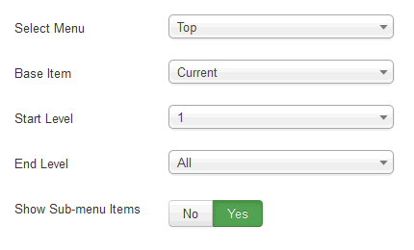
Select USB READER we will only support 1-3 readers to start off with so the drop menu will just show 1-3 NFC reader models. You will just provide a index for the drop menu (example (Index = 0 represents SONY RC-S380/S ， index = 1 ACS ACR122U)
Select USB Reader
Select USB Reader
Upload Image
Visitor Badge
Logistics Template
Price Tag
Blank Template

Slide 5

Upload IMAGE: user can upload BMP image or JPG file
Select USB Reader
image file
Select E-Paper Tag Screen Size
4.2” : resolution 400(h) x 300(w)
2.7”: resolution 264 x 176
2.1”: resolution 212 x 104
Upload Image
Visitor Badge
Logistics Template
PREVIEW
Price Tag
Blank Template
SEND
Notes:
1 bit BMP
Color JPG -> dithering -> 1 bit BMP

Slide 6


Visitor Badge: Clicking on photo icon, triggers laptop camera. User then fills out visitor name, company, and date User can take a picture. Picture will be formatted to take up. The size of the photo on the e-paper screen can be decided by you. Then clicking the arrow button will generate the image for their approval NAME COMPANY : should let users know MAX characters they can input (this should vary by which size screen they choose and what font/font size you will implement for this design
Select USB Reader
Select E-Paper Tag Screen Size
4.2” : resolution 400(h) x 300(w)
2.7”: resolution 264 x 176
Upload Image
Name:
Company:
Date:
Visitor Badge
Take photo
Logistics Template
Automatically Generates current date
Price Tag
Blank Template

Slide 7
Visitor Badge: preview – user can choose to send image or go back to make edits
Select USB Reader
PREVIEW
Upload Image
Jay Wey
Company
7/19/16
Visitor Badge
Logistics Template
Price Tag
Blank Template
SEND

Slide 8
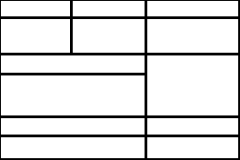
Logistics Template: Fixed background. User can choose what content to write in each box (13 boxes). Clicking arrow will generate preview should let users know MAX characters they can input in each box (this should vary by which size screen they choose and what font/font size you will implement for this design
Select E-Paper Tag Screen Size
4.2” : resolution 400(h) x 300(w)
2.7”: resolution 264 x 176
Select USB Reader
Upload Image
Visitor Badge
Logistics Template
Price Tag
Blank Template

Slide 9
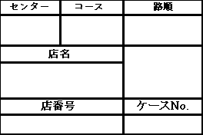
Logistics Template: preview – user can choose to send image or go back to make edits
IMAGE PREVIEW
Select USB Reader
Upload Image
Visitor Badge
Logistics Template
Price Tag
Blank Template
SEND

Slide 10
SENDING:
When any image is sent - “…sending” screen is.
Select USB Reader
…sending
Upload Image
Visitor Badge
Logistics Template
Price Tag
Blank Template

Slide 11

SENDING:
Send button should be an empty function that we will define. When transmission is successfully completed, a confirmation will be received and “transmission complete” screen will be displayed . After image is sent, the screen will return previous send image screen so user can choose to resend image or make edits.
Select USB Reader
COMPLETE
Upload Image
Visitor Badge
Logistics Template
Price Tag
Blank Template

Slide 12
Price Tag Template:
user can upload image
Should let users know MAX characters they can input in each box (this should vary by which size screen they choose and what font/font size you will implement for this design
Select E-Paper Tag Screen Size
4.2” : resolution 400(h) x 300(w)
2.7”: resolution 264 x 176
Select USB Reader
Upload Image
Product Name:
Price:
Detials:
Visitor Badge
Upload photo
Logistics Template
Price Tag
Blank Template

Slide 13
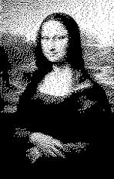
Price Tag Template:
preview – user can choose to send image or go back to make edits
IMAGE PREVIEW
Select USB Reader
Painting
Upload Image
$350.99
Visitor Badge
Logistics Template
1850 Mona lisa painting by artist named van gogh
Price Tag
Blank Template
SEND

Slide 14
Blank Template:
User can input custom text to be displayed in a large text size in the middle of e paper screen
Should let users know MAX characters they can input in box (this should vary by which size screen they choose and what font/font size you will implement for this design
Select E-Paper Tag Screen Size
4.2” : resolution 400(h) x 300(w)
2.7”: resolution 264 x 176
Select USB Reader
Upload Image
LARGE CENTERED TEXT
Visitor Badge
Logistics Template
Price Tag
Blank Template

Slide 15
Blank Template:
preview – user can choose to send image or go back to make edits
IMAGE PREVIEW
Select USB Reader
Upload Image
A7390
Visitor Badge
Logistics Template
Price Tag
Blank Template
SEND

Slide 17
END

